Slide 1
Theory of Computation
CSE 3101
Lecture # 13
Md. Manowarul Islam
Lecturer, Dept of CSE
Jagannath University

Slide 2
Grammar

Slide 3
Intro to Languages
English grammar tells us if a given combination of words is a valid sentence.
The syntax of a sentence concerns its form while the semantics concerns its meaning.
e.g. the mouse wrote a poem
From a syntax point of view this is a valid sentence.
From a semantics point of view not so fast…perhaps in Disney land
Natural languages (English, French, Portguese, etc) have very complex rules of syntax and not necessarily well-defined.

Slide 4
Formal Language
Formal language – is specified by well-defined set of rules of syntax
We describe the sentences of a formal language using a grammar.
Two key questions:
1 - Is a combination of words a valid sentence in a formal language?
2 – How can we generate the valid sentences of a formal language?
Formal languages provide models for both natural languages and programming languages.

Slide 5
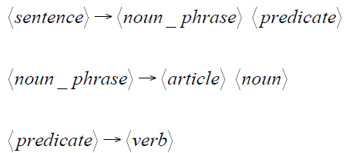
Regular Expressions vs. Finite Automata
Grammars express languages
Example: the English language

Slide 6

Basic concept
Production rule
Example: the English language
Variable
terminal

Slide 7
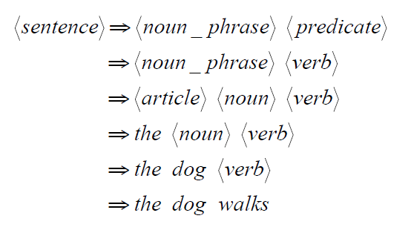
Regular Expressions vs. Finite Automata
Grammars express languages
Example: the English language

Slide 8
Definition
Grammars express languages
A grammar is a 4-tuple G = (V_{N}, ∑ ,P, S), where
  V_{N} is a finite nonempty set whose elements are called variables
  ∑ is a finite nonempty set 'whose elements are called terminals
  P is a finite set whose elements are α β. Here α andβ are string on V_{N} ∪∑ .
  S is the start symbol.

Slide 9
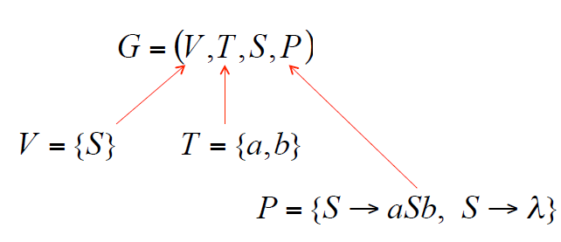
Definition
S aSb
S ∧
Example

Slide 10
Linear Grammars
Grammars with at most one variable at the right side of a production
S aSb
S ∧

Slide 11
Right-Linear Grammars
All productions have form:
Example
A→ xB
or
A→ x
terminals
S abS
S a

Slide 12
Left-Linear Grammars
All productions have form:
Example
A→ Bx
or
A→ x
terminals
S Aab
A Aab | B
B a

Slide 13
Regular Grammars
A regular grammar is any right-linear or left-linear grammar
Example
S Aab
A Aab | B
B a
S abS
S a

Slide 14
Language
Let G(V,T,S,P) be a phrase-structure grammar.
The language generated by G (or the language of G) denoted by L(G) , is the set of all strings of terminals that are derivable from the starting state S.
L(G)= {w ∈ T* | S =>*w}

Slide 15
Language of a Grammar
Grammar can produce some set of strings
Set of strings over an alphabet is a language
Language of a grammar is all strings produced by the grammar
Example
S aSb
aaSbb
aaaSbbb
aaabbb
S aSb
S ∧

Slide 16
Language of a Grammar
S aSb
aaSbb
aaaSbbb
aaaaSbbbb
aaaabbbb
S aSb
S ∧

Slide 17


Language of the grammar with the productions:

Slide 18
END

